Slide 1

Projet Informatique
IN104
Natalia Díaz Rodríguez, ENSTA Paris, Institut Polytechnique Paris

Slide 2
Logistics
The most up-to-date material is in the Course repository
Project preferences: Make 3 choices (in decreasing order of preference) here
Deadline to choose one of the 8 topics: 1st April at NOON (1st come, 1st served)
Think about your project well, once submitted, your answer cannot be changed.
Beware: may not be possible to accommodate everyone; we need balanced groups, respond timely today!
Especially with COVID rules, we can’t allocate more students to a salle than their max capacity
Notes:
Moodle Course page includes material, but

Slide 3
Logistics (II)
IN104 must help you learn manage your autonomy and independence
Essential today for an engineer
1 ECTS = 25h of work (all included) -> Expect Min. 2h weekly of extra work at home required
What are normal grades from past years?
No Exam -> Everything between 10 -12 and 20.
Up to you to get beyond average
A self-learning project
Internet is to be used
Notes:
1 ECTS = 25h travail tous compris.
Total: 10 seances (9 including defense last day + 1 autonomous without teaching assistant).
3 first lectures (in auditorium): Project Management Tools: OOP, GIT, TDD. 1h CM + 2h TD.
Rest of lectures: Autonomous Work on Project

Slide 4
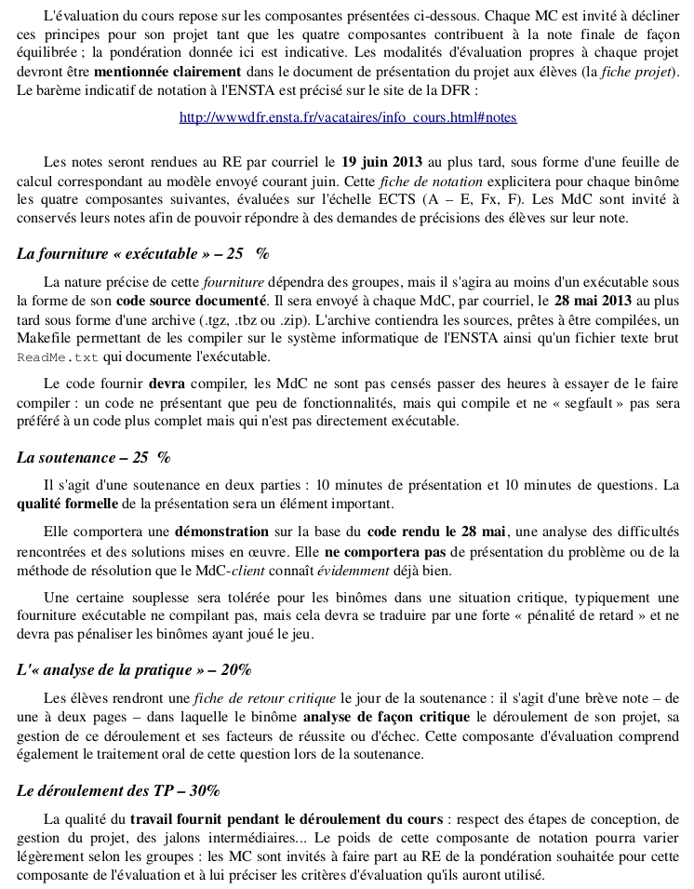
Logistics (III): Evaluation
25% Source code: features, tests, code documentation, etc. Source code must be documented, the report including a link to the repository must be in a .zip file. The repository will contain the sources, as well as a plain text file README.md which indicates the actual operational features and limitations. Python code should compile, the teaching assistants are not supposed to make significant corrections for it to compile: a code with few features, but that compiles and does not crash will be preferred to a more complete code but which is not directly operational!
25% Defense (10 minutes presentation, 5 min. questions): The formal quality of the presentation will be an important element. The defense needs to include a demonstration on the basis of the source code, an analysis of the difficulties encountered and implemented solutions. It will not include a presentation of the problem or the method of resolution that the teaching assistant obviously knows already well. The defense is open to everyone (subject to the acceptance of the pair that will present). The chronological order of defense will be given by the list of each group.
20% Practice Analysis: You will return a critical (max. 5 pages) report before the defense in which you analyze and criticize the progress of your project and its success and failure factors. This evaluation component also includes the oral treatment of this question during the defense.
30% Continuous Progress Evaluation of the practical work during the practical lab sessions (based on Git commits).
Notes:
1 ECTS = 25h travail tous compris.
Total: 10 seances (9 including defense last day + 1 autonomous without teaching assistant).
3 first lectures (in auditorium): Project Management Tools: OOP, GIT, TDD. 1h CM + 2h TD.
Rest of lectures: Autonomous Work on Project

Slide 5
Plagiarism control
Checks for plagiarism will be performed.
Last year, the copying team took a lot of time, conversation, Zoom meetings, and uncomfortable moments, please do not copy code, we find out.
Showing signs of copying material is enough reason to have to repeat the course next year.

Slide 6
COVID-19 safety rules
How can we work in pairs if we need to keep 1m distance?
This is the challenge of COVID era ;)
You are allowed to communicate via:
Voice
Sitting in the nearest allowed desk and talking
You can communicate the usernames and the repository urls of your project via voice/email/chat.
The same will apply for the rest of the course as work is in binoms (teams of 3 if someone is alone only).

Slide 7
Timetable
Session 1 Projects presentations and Intro to GIT
TD: GIT Practical guide and exercises
Session 2 Object Oriented Programming (OOP) and Python.
TD: Project 0: Unix/Python/ OOP Tutorial: Submit via Gradescope. Deadline: 1 week)
Session 3 Test Driven Development (TDD).
TD: TDD Practical.
Rest of sessions: Work on Project week
Last Session Project Defense Day (10 min of soutenance per team including questions)
Deadline to send report (containing link to project repository) to your Teaching Assistant: Latest 2 days before defense day
Groups assigned in TD1 are not definitive. They change for the rest of the course in session 2
Choose who you want to work with in your project, he needs to have been assigned in your same group, so do not choose until you have been communicated the project you will be working on.
Notes:
Optional: 2 sessions before last: [TD-Dependent] Mid-term progress report: Deadline: 22/4/2019

Slide 8
Minimum to pass the course
Implement and use some classes and objects in your project
Implement and run successfully some unit tests.
Play the Git game of push/pull:
Coordinate work in the team using Git to incrementally progress on the project
Your teaching assistant (TA) will check your Github repository commit, pull, push… through the course duration

Slide 9

Course expectations
This is your (first) independent project course
i.e., autonomous work expected
Time in lab is not expected to be sufficient to hand in a high quality project and report
Expected total work hours: at the very least, same amount of lab time, at home
Report: 1 single PDF containing link to repository:
Quality over Quantity
Results (plots, insights, conclusions and learnings):
more important than lengthy reports explaining the problem
Notes:
Synthesis capability, learnings and analysis you put into the project, assessing your scientific curiosity

Slide 10
If you feel lost
Establish milestones with your partner
Do GIT code reviews (of each other, if needed)
Force yourself: pose the right question you want to answer
Set up Zoom weekly meetings with your binom to work on the project after the TD
Your TA is there to support you!
Notes:
1 ECTS = 25h travail tous compris.
Total: 10 seances (9 including defense last day + 1 autonomous without teaching assistant).
3 first lectures (in auditorium): Project Management Tools: OOP, GIT, TDD. 1h CM + 2h TD.
Rest of lectures: Autonomous Work on Project
Milestones: jalon

Slide 11
If you feel lost
Mid-term report hand in:
Show to your TA, at least, the first 50% of your project report in the equator of the course
makes sure you are on track
can help you not derail. You can include:
Project Requirements
Software Architecture
Classes, Tests, Plots, Versions, Documentation...
Notes:
1 ECTS = 25h travail tous compris.
Total: 10 seances (9 including defense last day + 1 autonomous without teaching assistant).
3 first lectures (in auditorium): Project Management Tools: OOP, GIT, TDD. 1h CM + 2h TD.
Rest of lectures: Autonomous Work on Project

Slide 12
Course & Team Python Conventions
PEP-8: Defines Python coding practices https://www.python.org/dev/peps/pep-0008
Indentation: 4 spaces (good editors will replace <TAB> by 4 spaces)
Variables: lower_case_with_underscores
Functions: lower_case_with_underscores()
Classes: UpperCamelCase
Attributes: lower_case_with_underscores
Protected attributes: _prefixed_with_1_underscore
Constants: ALL_CAPS
Modules: lowercase (single word)
PEP-257: Documentation conventions.
Prescribes the function or method’s effect as a command (“Do this”, “Return that:”).
Docstring should NOT be a “signature” (reiterating the function/method parameters, which can be obtained by instrospection).
Notes:
a docstring is a string literal specified in source code that is used, like a comment, to document a specific segment of code. [JD Giraud credits]

Slide 13
References & Acknowledgements
Jean-Didier Garaud. Coding Best Practices
Resources to learn Scientific Python: scipy, pandas, numpy: https://github.com/paris-saclay-cds/data-science-workshop-2019
Lutz, M CC. (2011). Programming Python (4.a ed.). EE. UU.: O’Reilly Media.
Lutz, M (2013). Learning Python (5.a ed.). EE. UU.: O’Reilly Media.
Martelli, A (2017). Python in a Nutshell (3.a ed.). EE. UU.: O’Reilly Media.
Pilgrim, M (2011). Dive Into Python 3(online). APress. http://www.diveintopython3.net
Python Software Foundation. Python Official Webpage. <http://www.python.org>
González Duque, R. Python para todos (on line).
Photography: Sandy Skoglund

Slide 14
5 min Project Pitchs Time!

Slide 15
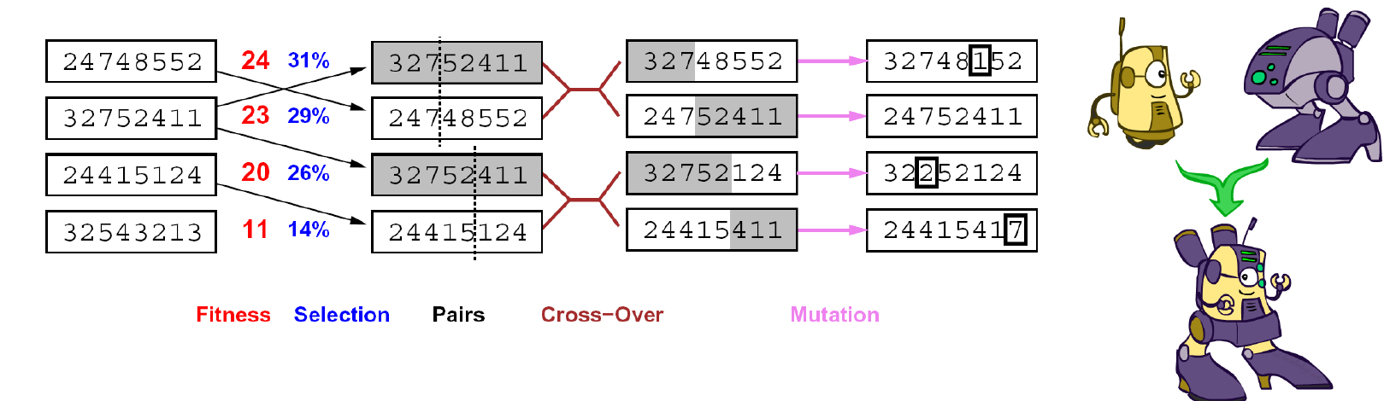
Project 1: GENETIC ALGORITHMS
Natalia Díaz Rodríguez Github username: NataliaDiaz
Commonly used to generate high-quality solutions to optimization and search problems by relying on bio-inspired operators
A metaheuristic belonging to the larger class of evolutionary algorithms (EA).
Inspired by a natural selection metaphor:
Keep best N hypotheses at each step (selection) based on a fitness function.
Have a pairwise crossover operator, with optional mutation to give variety
Notes:
Genetic Algorithms (GA):
Commonly used to generate high-quality solutions to optimization and search problems by relying on bio-inspired operators: such as mutation, crossover and selection.

Slide 16
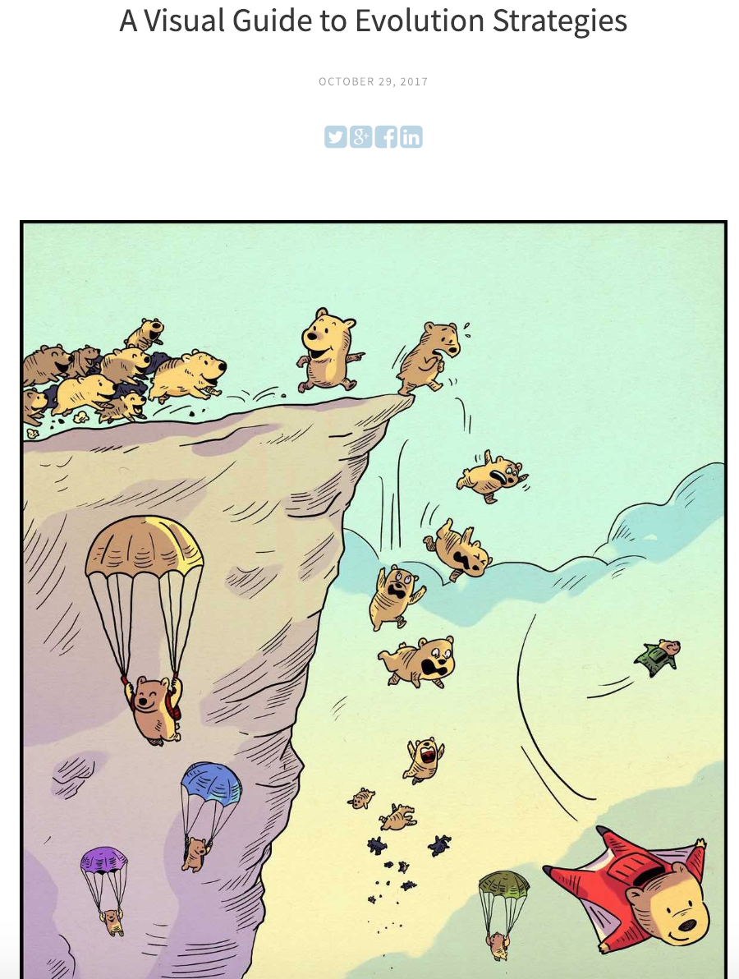
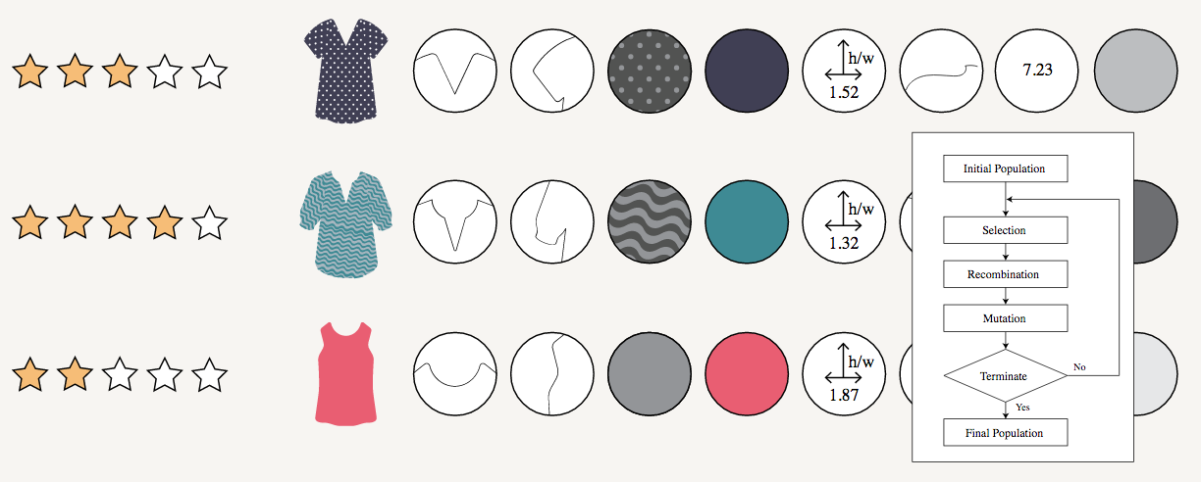
Project 1: GENETIC ALGORITHMS
Natalia Díaz Rodríguez

Slide 17
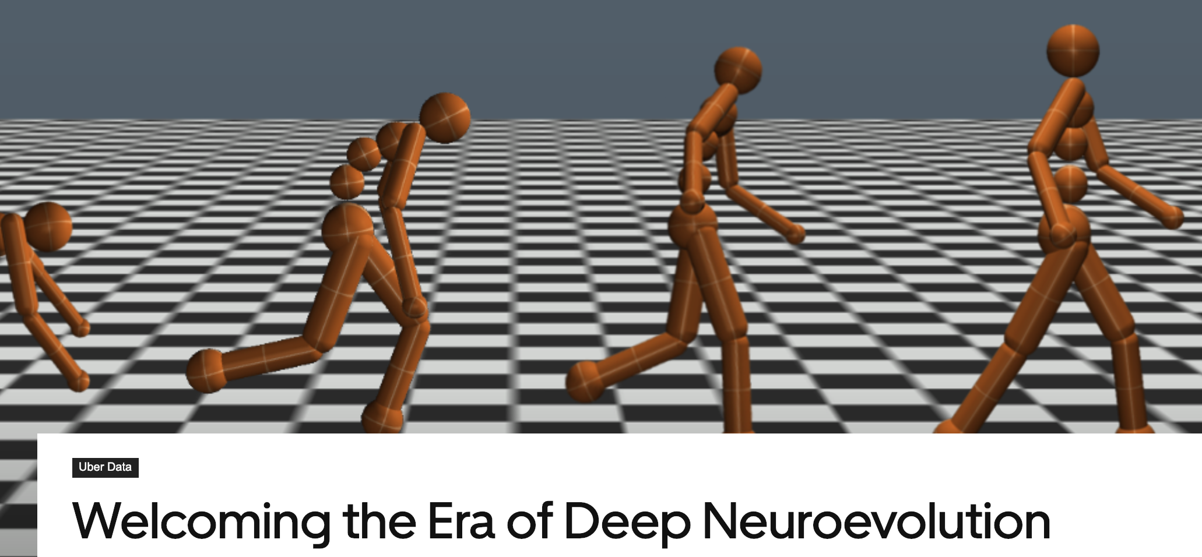
Project 1: GENETIC ALGORITHMS
Natalia Díaz Rodríguez
Intro reads:
GA: https://en.wikipedia.org/wiki/Genetic_algorithm
EA: https://en.wikipedia.org/wiki/Evolutionary_algorithm
Visual Evolution Strategies: http://blog.otoro.net/2017/10/29/visual-evolution-strategies/
The Era of Deep Neuroevolution (Uber AI Labs): https://eng.uber.com/deep-neuroevolution/
An intro to genetic algorithms and an example of real industry application on data-driven fashion design https://multithreaded.stitchfix.com/blog/2016/07/14/data-driven-fashion-design/
Contact: natalia.diaz(at)ensta-paris(dot)fr
https://github.com/NataliaDiaz/IN_104-Projet-Informatique

Slide 18


Project 2: SEARCH ENGINE FOR COVID-19
Jessica López Espejel Github username: jessicalopezespejel
A Search Engine for Covid-19 will help the doctors and researchers to find faster articles related to the keywords they are searching for.
Inspired by the pandemic situation we are living in all the world.
Challenge
Build your own search engine specialized in Covid-19.
Use Natural Language Processing strategies.
Tools
Python >=3.6; Pandas; Tokenizers such as Scispacy, Spacy, Nltk, etc. Sklearn, Whoosh.

Slide 19




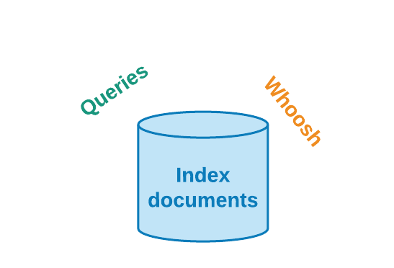
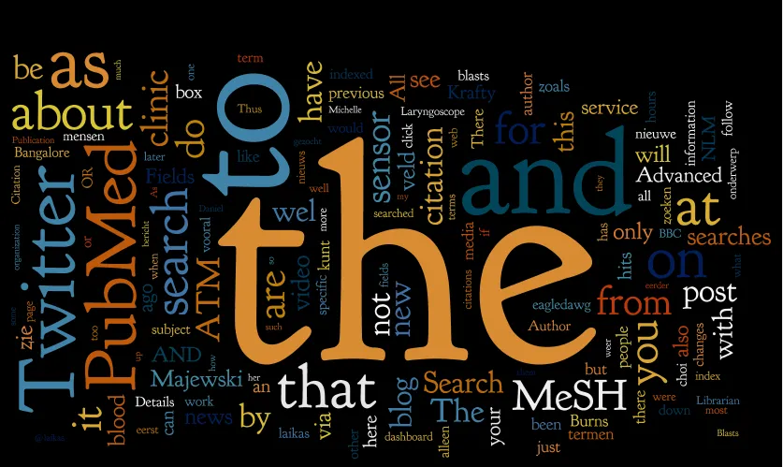
Project 2: SEARCH ENGINE FOR COVID-19
Jessica López Espejel Github username: jessicalopezespejel
Lemmatization
Tokenization
Stop words

Slide 20
Project 2: SEARCH ENGINE FOR COVID-19
Jessica López Espejel Github username: jessicalopezespejel
Intro reads
https://pandas.pydata.org/pandas-docs/stable/user_guide/10min.html
https://medium.com/data-science-in-your-pocket/tokenization-algorithms-in-natural-language-processing-nlp-1fceab8454af
https://towardsdatascience.com/stemming-lemmatization-what-ba782b7c0bd8
https://towardsdatascience.com/stemming-lemmatization-what-ba782b7c0bd8
https://whoosh.readthedocs.io/en/latest/indexing.html
https://medium.com/@swapnilggourshete/how-indexes-on-database-works-15efa266fda6
https://medium.com/@abhilashbss/how-indexing-works-in-databases-931c8a73ea42
Contact: jessicalopezespejel(at)gmail(dot)com
More details: https://github.com/JessicaLopezEspejel/N_104-Projet-Informatique

Slide 21
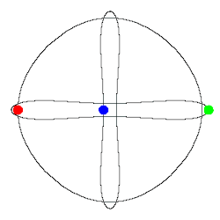
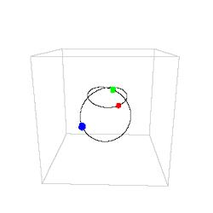
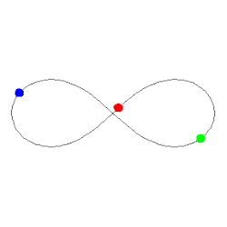
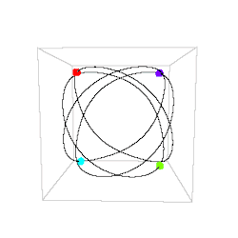
Project 3: N-Body problem
Simulate a (very) tiny universe
Ismail Bennani <ismail.lahkim.bennani@ens.fr>
“The n-body problem is the problem of predicting the individual motions of a group of celestial objects interacting with each other gravitationally” - Wikipedia
You will learn about:
Physics engines
Numerical integration schemes:
approximate solutions of Ordinary Differential Equations
inherent tradeoff between speed and accuracy
2D/3D drawing:
basic 2D drawing primitives
3D projection on a 2D plane
GIFs from http://rebloggy.com/post/gif-gifset-science-math-physics-n-body-problem-orbits/39788206329
Examples: https://vanderbei.princeton.edu/WebGL/nBody.html

Slide 22
Project 3: N-Body problem
Simulate a (very) tiny universe
Ismail Bennani <ismail.lahkim.bennani@ens.fr>
Your job (mandatory):
Write a physics engine computing the forces applied to each body
Write a an ODE solver to integrate the dynamics
Write a 2D graphical interface to show the results
The rest is up to you, you can:
Compute physics faster, e.g. simulate an asteroid belt (700.000 to 1.7M asteroids in our solar system)
Compute more accurate dynamics (Leapfrog algorithm, Runge-Kutta family, …)
Handle collisions between bodies
Add features to the GUI, e.g. control the camera with your mouse, draw trajectories of bodies, …
Simulate the systems in a 3D space and project it on screen
… be creative !
Tool suggestions
Language | Python
2D drawing lib | Pygame
More details: https://github.com/ismailbennani/IN104/blob/master/sujet/sujet.pdf
Git repo: https://github.com/ismailbennani/IN104
Github username: ismailbennani

Slide 23
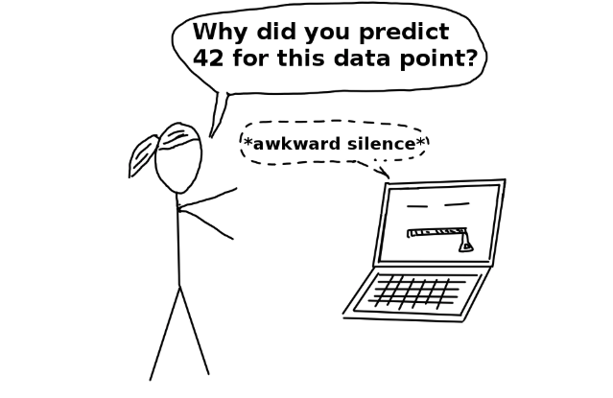
Project 4: Titanic survivor prediction and explainable artificial intelligence techniques Silvia Tulli, INESC-ID, IST and Sorbonne.
Github: https://github.com/Silviatulli
silvia.tulli.92@gmail.com
Projet de machine learning
En utilisant la base de donnés du titanic, prédire quels seront les passagers qui réussiront à survivre à l’aide d’un modèle de machine learning
Le but du projet est d’expliquer, de donner des informations sur ce que le modèle a appris (sur quoi se base-t-il pour prendre ses décisions?)
Additional details: https://github.com/Silviatulli/IN104

Slide 24
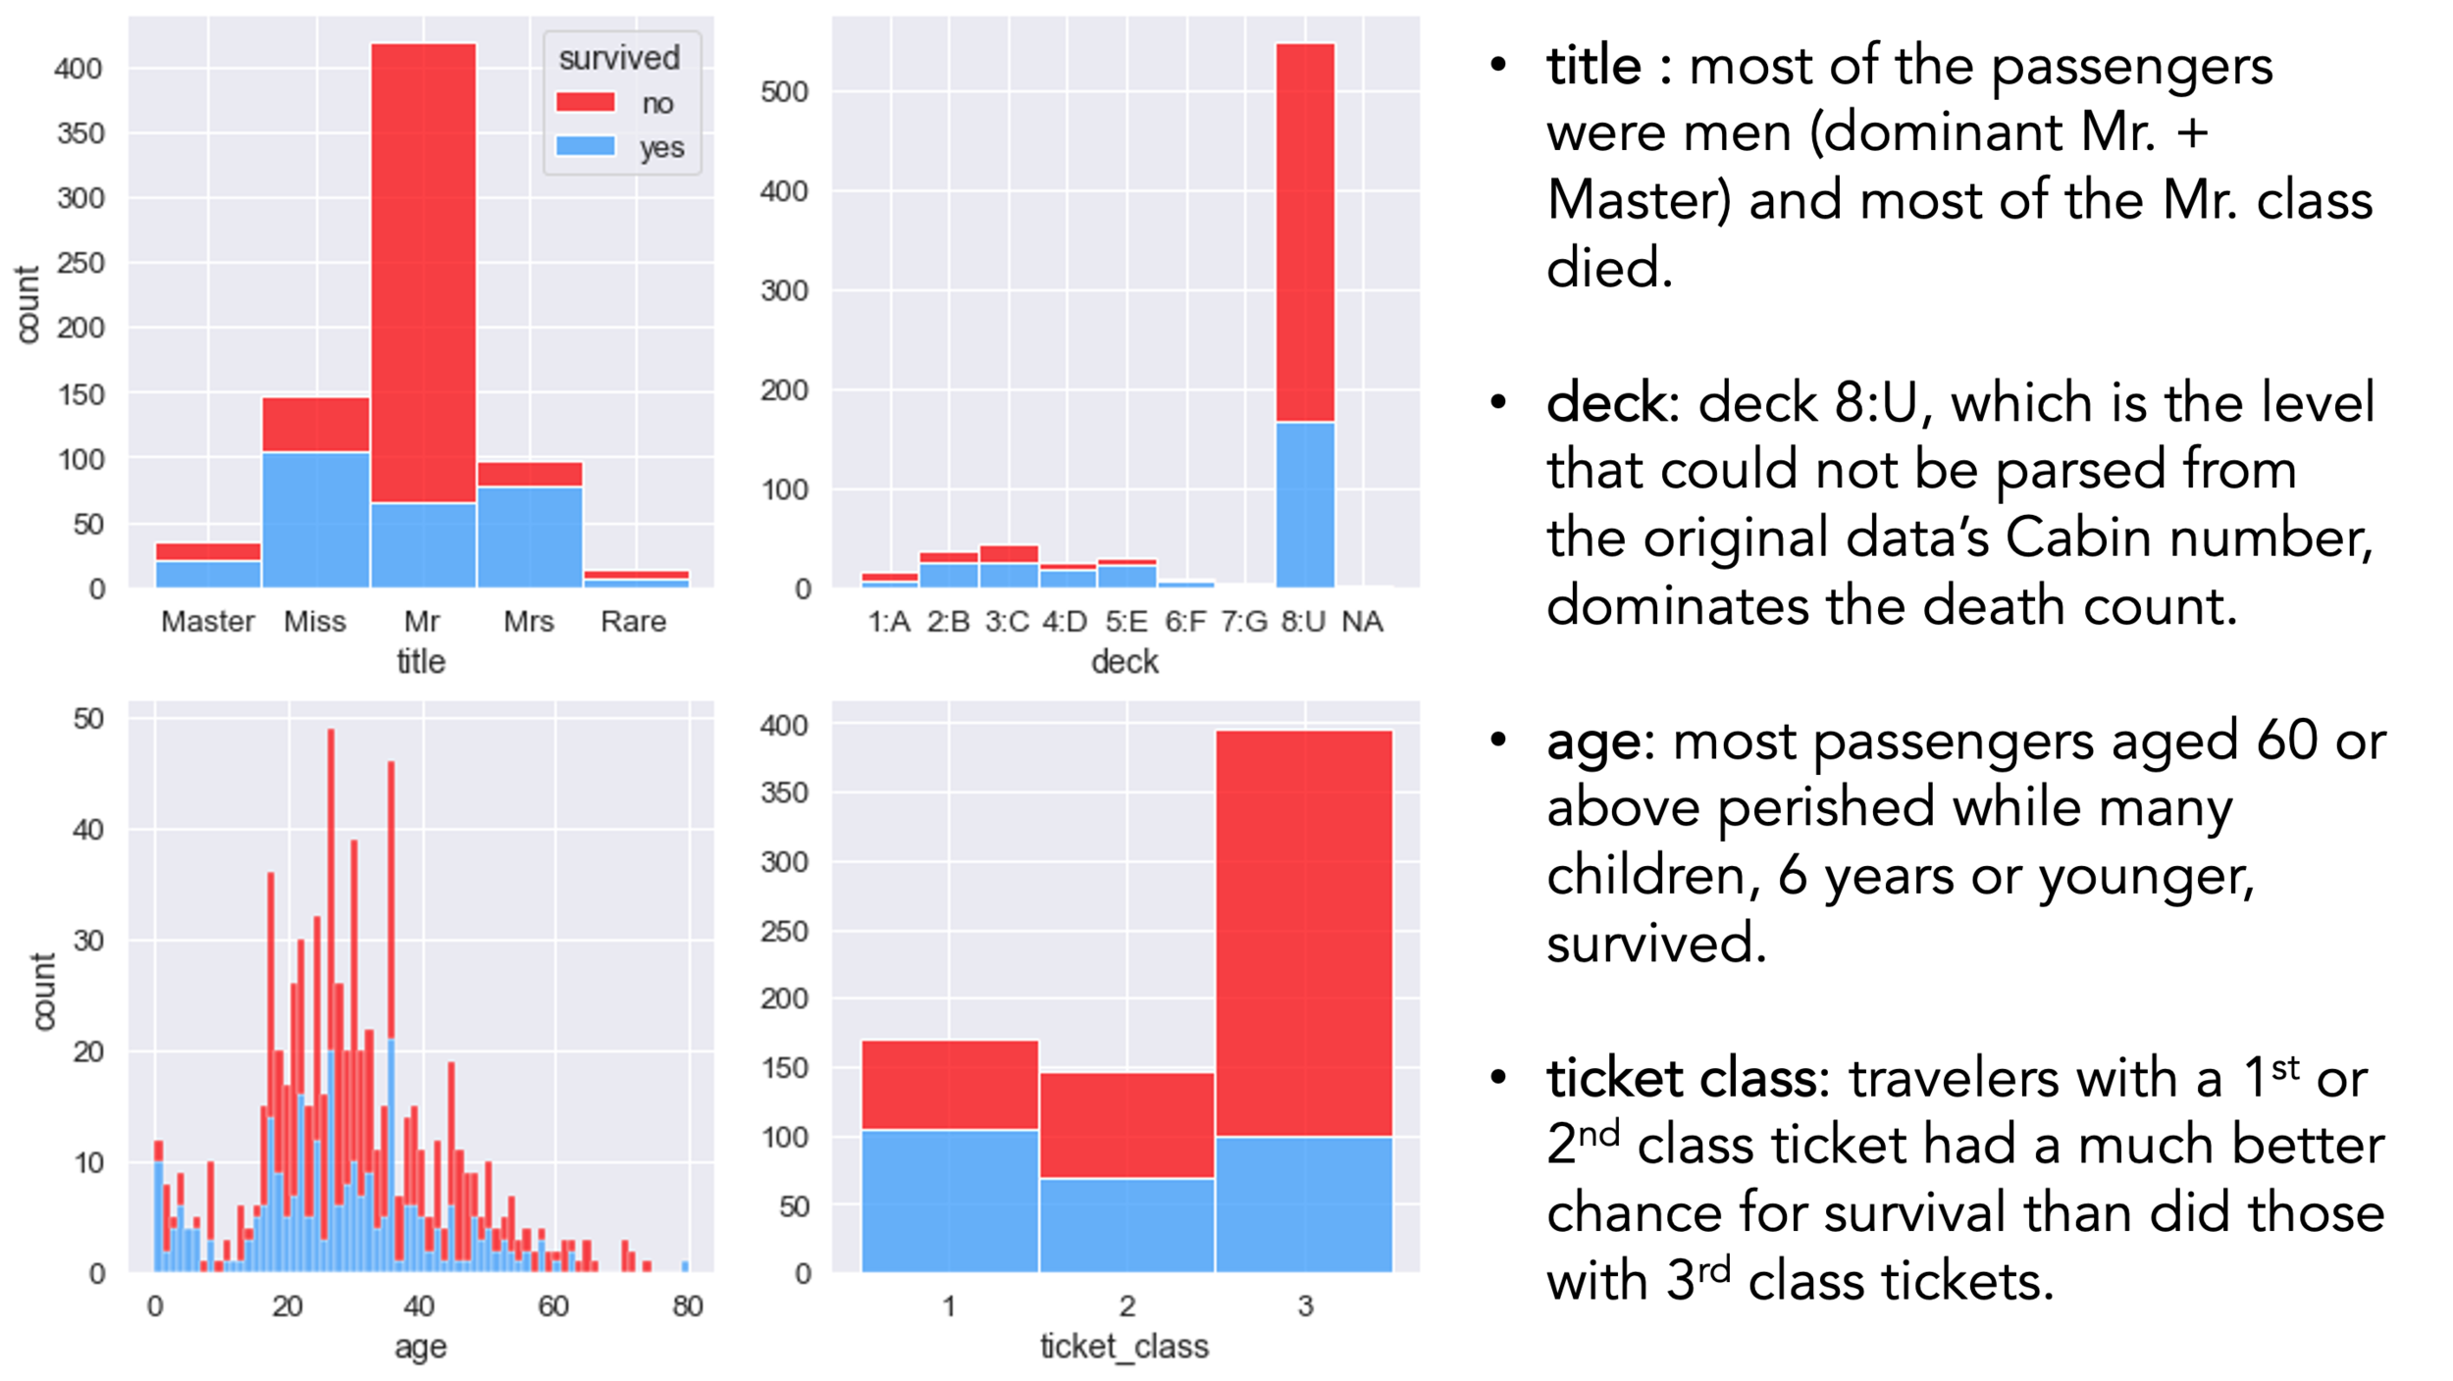
Project 4: Titanic survivor prediction and explainable artificial intelligence techniques Silvia Tulli, INESC-ID, IST and Sorbonne.
Github: https://github.com/Silviatulli
silvia.tulli.92@gmail.com
Le choix du modèle est laissé libre (Random Forest, SVM)
Des exemples d’implémentation avec la bibliothèque sklearn seront fournis
Pour l’explicabilité, deux méthodes devront être utilisées(des exemples de code seront fournis) : Partial Dependence Plot (PDP) et accumulated local effects (ALE)
Explorer ce que peut apporter PDP et ALE en terme d’explicabilité

Slide 25
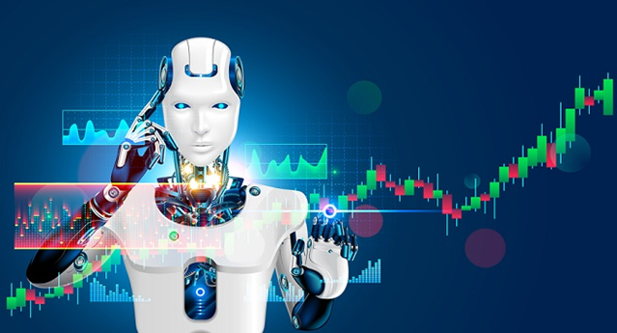
Project 5: Trading Bot in the European Weather and Energy Markets
Eliot Tabet
Compréhension du marché de l’énergie (gaz/électricité) et l’impact du climat dans ce marché
Prévision de la consommation
Prise de décision sur la position à prendre (Buy/Sell) en se basant sur les algorithmes de machine learning
https://drive.google.com/drive/folders/1o9m_fSyRIx9L26HXHe1cnxhT_F9vnxzB?usp=sharing
eliot.tabet@polytechnique.edu

Slide 26
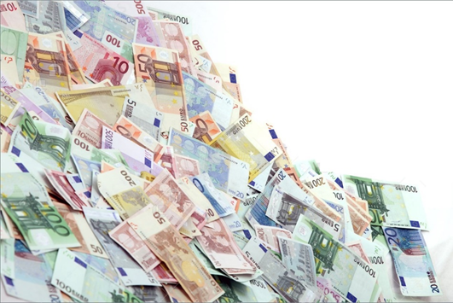
Project 5: Trading Bot in the European Weather and Energy Markets
Eliot Tabet
Python: Pandas, Numpy, SciPy, SkLearn, Matplotlib, dfply
Supervised Learning Algorithms (Classification and Regression): Random Forest, Logistic Regression, Non-linear regression, Multidimensional Linear Regression
https://drive.google.com/drive/folders/1o9m_fSyRIx9L26HXHe1cnxhT_F9vnxzB?usp=sharing
eliot.tabet@polytechnique.edu

Slide 27
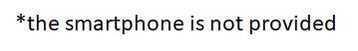

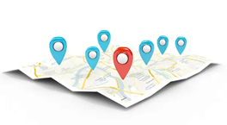

Project 6: Build a navigation app for your phone* Stephen Creff
Use native or cross-platform app development framework to build an iOS or Android app,
Choose your language (Python, Java, …) and find your development framework (tech stack),
Discover and understand the framework and the APIs (widgets, …)
Make your System Analysis and Requirements,make it incremental!
Add features and sensors solicitation step by step, from trivial to rich location-based
Define map (simplified, real, feature-rich), set geo-markers, calculate and draw route, …
Define a storyboard and mock-up the Interface design
Define and build functions using smartphone sensors
Touch screen, Geolocation service, …
Package & deploy your app on the targeted OS
stephen.creff@gmail.com
https://github.com/ctfun/IN104_2020

Slide 28
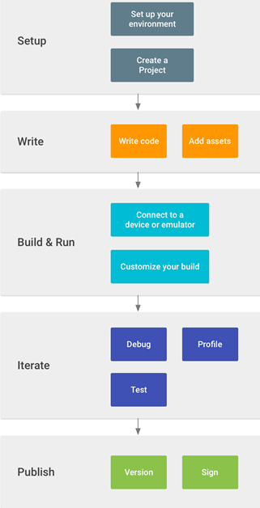
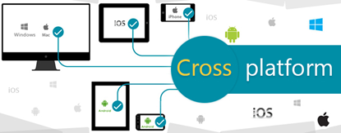
Project 6: Build a navigation app for your phone* Stephen Creff
Key points of the project:
Follow a full system development workflow,
Learn to program and use dedicated APIs,
Routing problem, pathfinding algorithms,
And, have fun with your phone !
Examples of frameworks to build Mobile Applications:
A python framework : https://kivy.org/#home
The react framework : https://reactnative.dev/
Other framework, with combination of many languages i.e., HTML5, JavaScript, and CSS and Cordova wrapper : https://ionicframework.com/

Slide 29
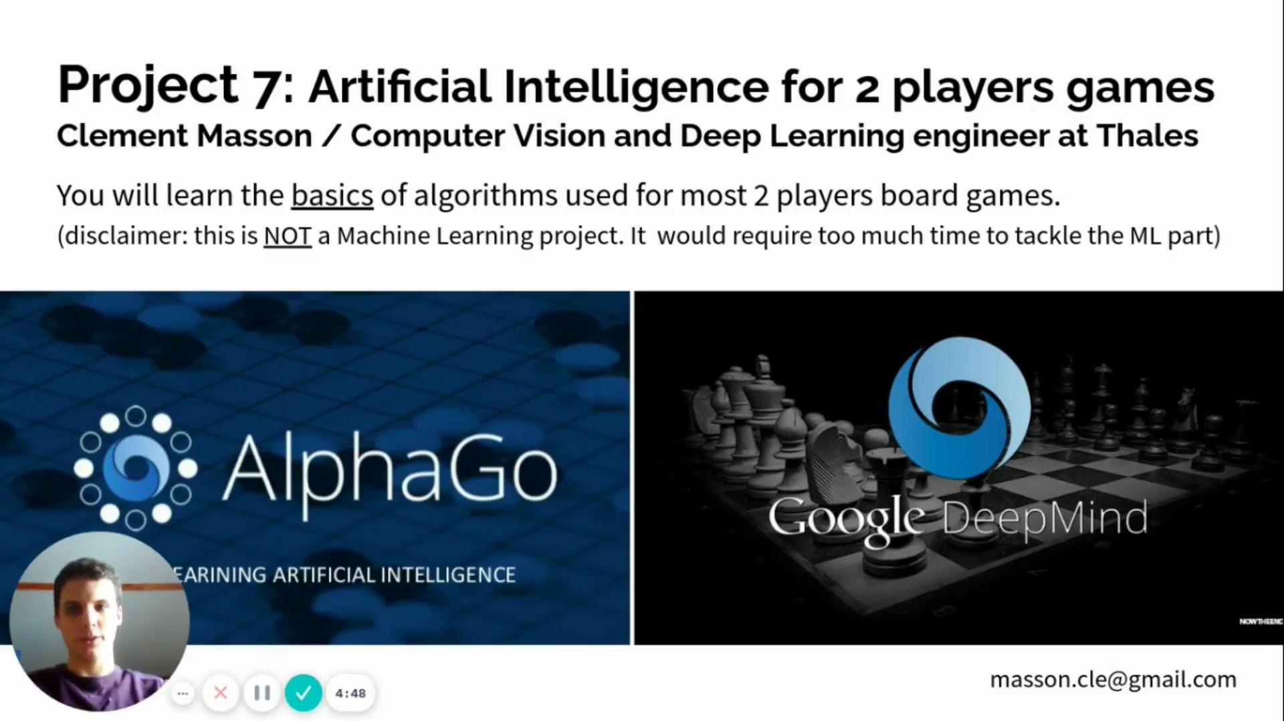
Project 7: Artificial Intelligence for 2 players games
Clement Masson / Computer Vision and Deep Learning engineer at Thales
masson.cle@gmail.com

Slide 30
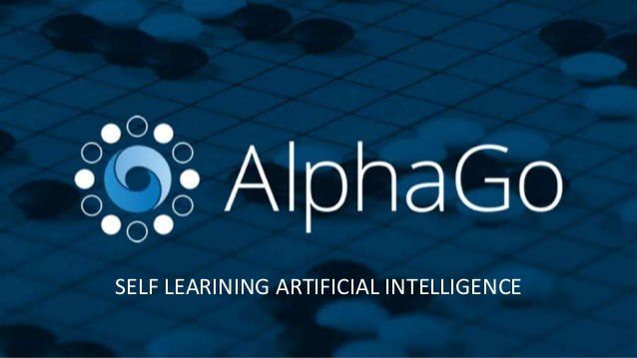

Project 7: Artificial Intelligence for 2 players games
Clement Masson / Computer Vision and Deep Learning engineer at Thales
You will learn the basics of algorithms used for most 2 players board games. (disclaimer: this is NOT a Machine Learning project. It would require too much time to tackle the ML part)
masson.cle@gmail.com

Slide 31
Project 7: Artificial Intelligence for 2 players games
Clement Masson
Language: python
Expected work: project will start with many guidelines so you know where to start.
Evaluation:
Oral presentation & report : 50 %
AI Competition ranking : 40%
Code quality, good use of git, deadline respect, work in group … : 10 %
Useful links: Project website (forum, guidelines, help, …): https://sites.google.com/view/ensta-in104 Wiki : https://github.com/clement-masson/aiarena/wiki
masson.cle@gmail.com

Slide 32
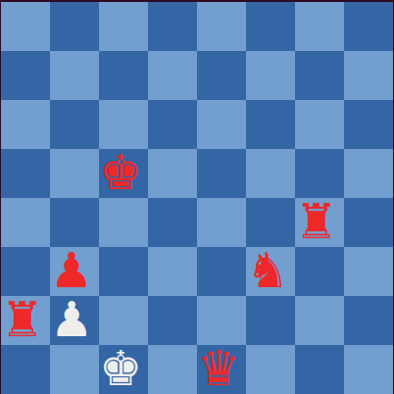
Project 7: Artificial Intelligence for 2 players games
Fun :
You can play against your own AI
Your AI will compete against other groups’ AI !
Interesting theory aspects :
Recursivity, Trees
Minimax, alpha-beta pruning
Object Programming
Code profiling and optimization
masson.cle@gmail.com

Slide 33
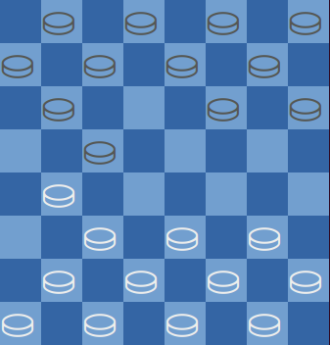
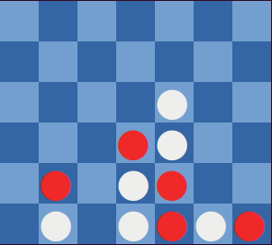

Project 7: Artificial Intelligence for 2 players games
Clement Masson
Some code is already provided to let you quickly start your implementation of AIs and play against them !
checkers
chess
connect4
abalone
masson.cle@gmail.com

Slide 34
Recap IN104
Link to slides and course material: https://github.com/NataliaDiaz/IN_104-Projet-Informatique
Lecture 1: Intro to GIT: Work in pairs for Session 1
Lecture 2: Intro to Object Oriented Programming (OOP): Groups change here for the rest of the course, choose who you want to work with in your project.
Lecture 3: Test Driven Development (TDD) in Python
Practical work (TD): indicated at the end of each Lecture slides
Notes:
Practicals (TDs): At the end of each Lecture

Slide 35
OUTDATED PROJECT: Thomas Rojat’s

Slide 36
Project 4: Titanic survivor prediction and explainable artificial intelligence techniques
•Projet de machine learning
•En utilisant la base de donnés du titanic, prédire quels seront les passagers qui réussiront à survivre à l’aide d’un modèle de machine learning
•Le but du projet est d’expliquer, de donner des informations sur ce que le modèle a appris (sur quoi se base-t-il pour prendre ses décisions?)
https://docs.google.com/document/d/1GwMIzYUrvZmVonxz19mEBA-CKCUsRCQ2kmG4gqppHnw/edit?usp=sharing

Slide 37
Project 4: Titanic survivor prediction and explainable artificial intelligence techniques (Thomas Rojat thomas.rojat@renault.com )
•Le choix du modèle est laissé libre (Random Forest, SVM)
•Des exemples d’implémentation avec la bibliothèque sklearn seront fournis
•Pour l’explicabilité, deux méthodes devront être utilisées(des exemples de code seront fournis) : Partial Dependence Plot (PDP) et accumulated local effects (ALE)
•Explorer ce que peut apporter PDP et ALE en terme d’explicabilité

